Slide 1

Data Science Capstone Project
Marcos Lopez Martinez
12/07/2023

Slide 2


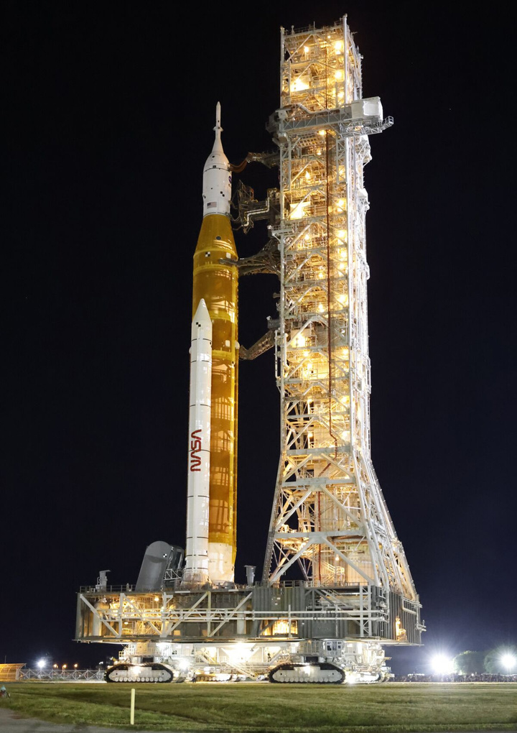
OUTLINE
Excecutive Summary
Introduction
Mathodology
Results
Conclusion
Appendix

Slide 3

Executive Summary
Summary of methodologies
Summary of all results
Data Collection
Data Wrangling
Exploratory Data Analysis with Data Visualization
Exploratory Data Analysis with SQL
Building an interactive map with Folium
Building a Dashboard with Plotly Dash
Classification/Predictive analysis
Exploratory Data Analysis results
Predictive analysis results
Interactive analytics

Slide 4

Introduction
The objective is to evaluate the viability of the new company "Space Y" to compete with Space X
Desirable answers:
The best way to estimate the total cost for launches, by predicting successful landing of the forst stage of rockets
Where is the best place to make launches

Slide 5
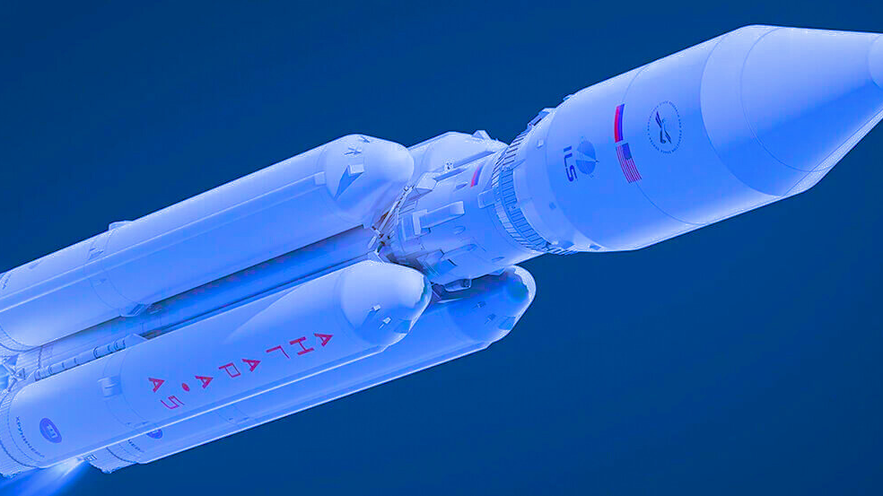
Methodology

Slide 6

Data collection methodology:
Space X API
WebScraping from Wikipedia
Data Wrangling:
Collected data was enriched by creating a landing outcome label based on autcome data after summarizing and analyzing features
Perform exploratory data analysis (EDA) using tolos and libraries of data visualization and SQL

Slide 7

Perform interactive visual analytics using Folium and Plotly Dash
Perform predictive analysis using classification models
Building, tuning and evaluation of classification models to ensure the best results
Data sets were collected from Space X API and from Wikipedia using web scraping technics

Slide 8

Data Collection:
SpaceX API
SpaceX offers a public API from where data can be obtained and then used
This API was used to extract data following the steps bellow:
Source code: https://github.com/MarcosLopez64/Capstone-Project-/blob/main/Data%20Collection%20API.ipynb
Request API and parse the SpaceX launch data
Filter data to only include Falcon 9 launches
Deal with missing values

Slide 9
Data Collection: WebScraping
Request the Falcon 9 launch in the wiki page
Data from SpaceX launches can also be obtained from Wikipedia
Data are downloaded according to the flowchart and then persisted
Exctract all columns/variables names from the HTML table header
Source code:
https://github.com/MarcosLopez64/Capstone-Project-/blob/main/Data%20Collection%20with%20Web%20Scraping.ipynb
Create a Data Frame by parsing the launch HTML tables

Slide 10
Data Wrangling
Initially some Exploratory Data Analysis (EDA) was performed on the dataset.
Then the summaries launches per site, occurrences of each orbit and occurrences of misión outcome per orbit type were calculated
Finally, the landing outcome label was created from Outcome column.
Creation of Landing Outcome Label
EDA
Summarizations
Source code:
https://github.com/MarcosLopez64/Capstone-Project-/blob/main/Data%20Wrangling.ipynb

Slide 11
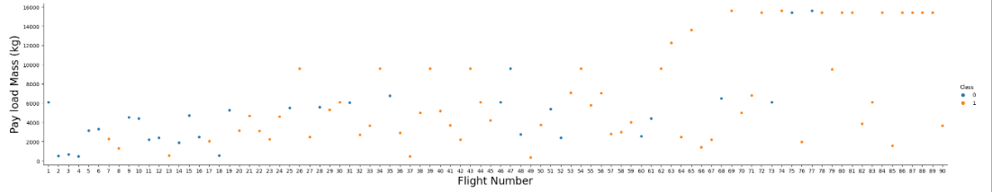
EDA with Data Visualization
To explore data, scatterplots and barplots were used to visualize the relationship between pair of features:
Payload Mass X Flight Number, Launch Site X Flight Number, Launch Site X Payload Mass, Orbit and Flight, Payload and Orbit
Source code:
https://github.com/MarcosLopez64/Capstone-Project-/blob/main/EDA%20with%20Data%20Visualization.ipynb

Slide 12
EDA with SQL
The following SQL queries were performed:
Names of the unique launch sites in the space misión
Top 5 launch sites whose name begin with the string “CCA”
Total payload mass carried by boosters launched by NASA (CRS)
Avarage payload mass carried by boosyer versión F9 v1.1
Date when the first successful landing outcome in ground pad was achieved
Names of the boosters wich have success in drone ship and have payload mass between 4000 and 6000 kg
Total number of successful and failure misión outcomes
Names of the booster versiona which have carried the máximum playload mass
Failed landing outcomes in drone ship, their booster versions, and launch site names for in 2015
Rank of the count of landing outcomes, such as Failure (drone ship) or Success (ground pad) between the 2010/06/04 and 2017/03/20
Source code:
https://github.com/MarcosLopez64/Capstone-Project-/blob/main/SQL%20and%20EDA.ipynb

Slide 13

Build an Interactive Map with Folium
Markers, circles, lines and marker clusters were used with Folium Maps:
Markers indicate points like launch sites
Circles indicate highlighted areas around specific coordinates, like NASA Johnson Space Center
Marker clusters indicates groups of events in each coordinate, like launches in a launch site
Lines are used to indicate distances between to coordinates
Source code:
https://github.com/MarcosLopez64/Capstone-Project-/blob/main/_Interactive%20Visual%20Analytics%20with%20Folium.ipynb

Slide 14
Build a Dashboard with Plotly Dash
Launch Sites Dropdown List:
Added a dropdown list anable Launch Site selection
Pie Chart showing Success Launches (All Sites/Certain Site):
Added a pie chart to show the total successful launches count for al sites and the Success vs. Failed counts for the site, if a specific Launch Site was selected.
Slider of Payload Mass Range:
Added a slider to select Payload range.
Scatter Chart of Payload Mass vs. Success Rate for the different Booster Versions:
Added a scatter chart to show the correlation between Payload and Launch Success
Source code:
https://github.com/MarcosLopez64/Capstone-Project-/blob/main/spacex_dash_app.py

Slide 15
Predictive analysis
Standardizing the data with StandarScaler, then fitting and transforming it
Splitting the data into training and testing sets with train_test_Split function
Creating a GridSearchCV object with cv=10 to find the best parameters
Creating a NumPy array from the column “Class” in data
Calculating the accuracy on the yesy data using the method .score() for all models
Applying GridSearchCV on LogReg, SVM, Decision Tree, and KNN models
Finding the method performs best by examining the Jaccard_score and F1_score
Examining the confusión matrix for all models
Source code:
https://github.com/MarcosLopez64/Capstone-Project-/blob/main/Machine%20Learning%20Prediction.ipynb

Slide 16
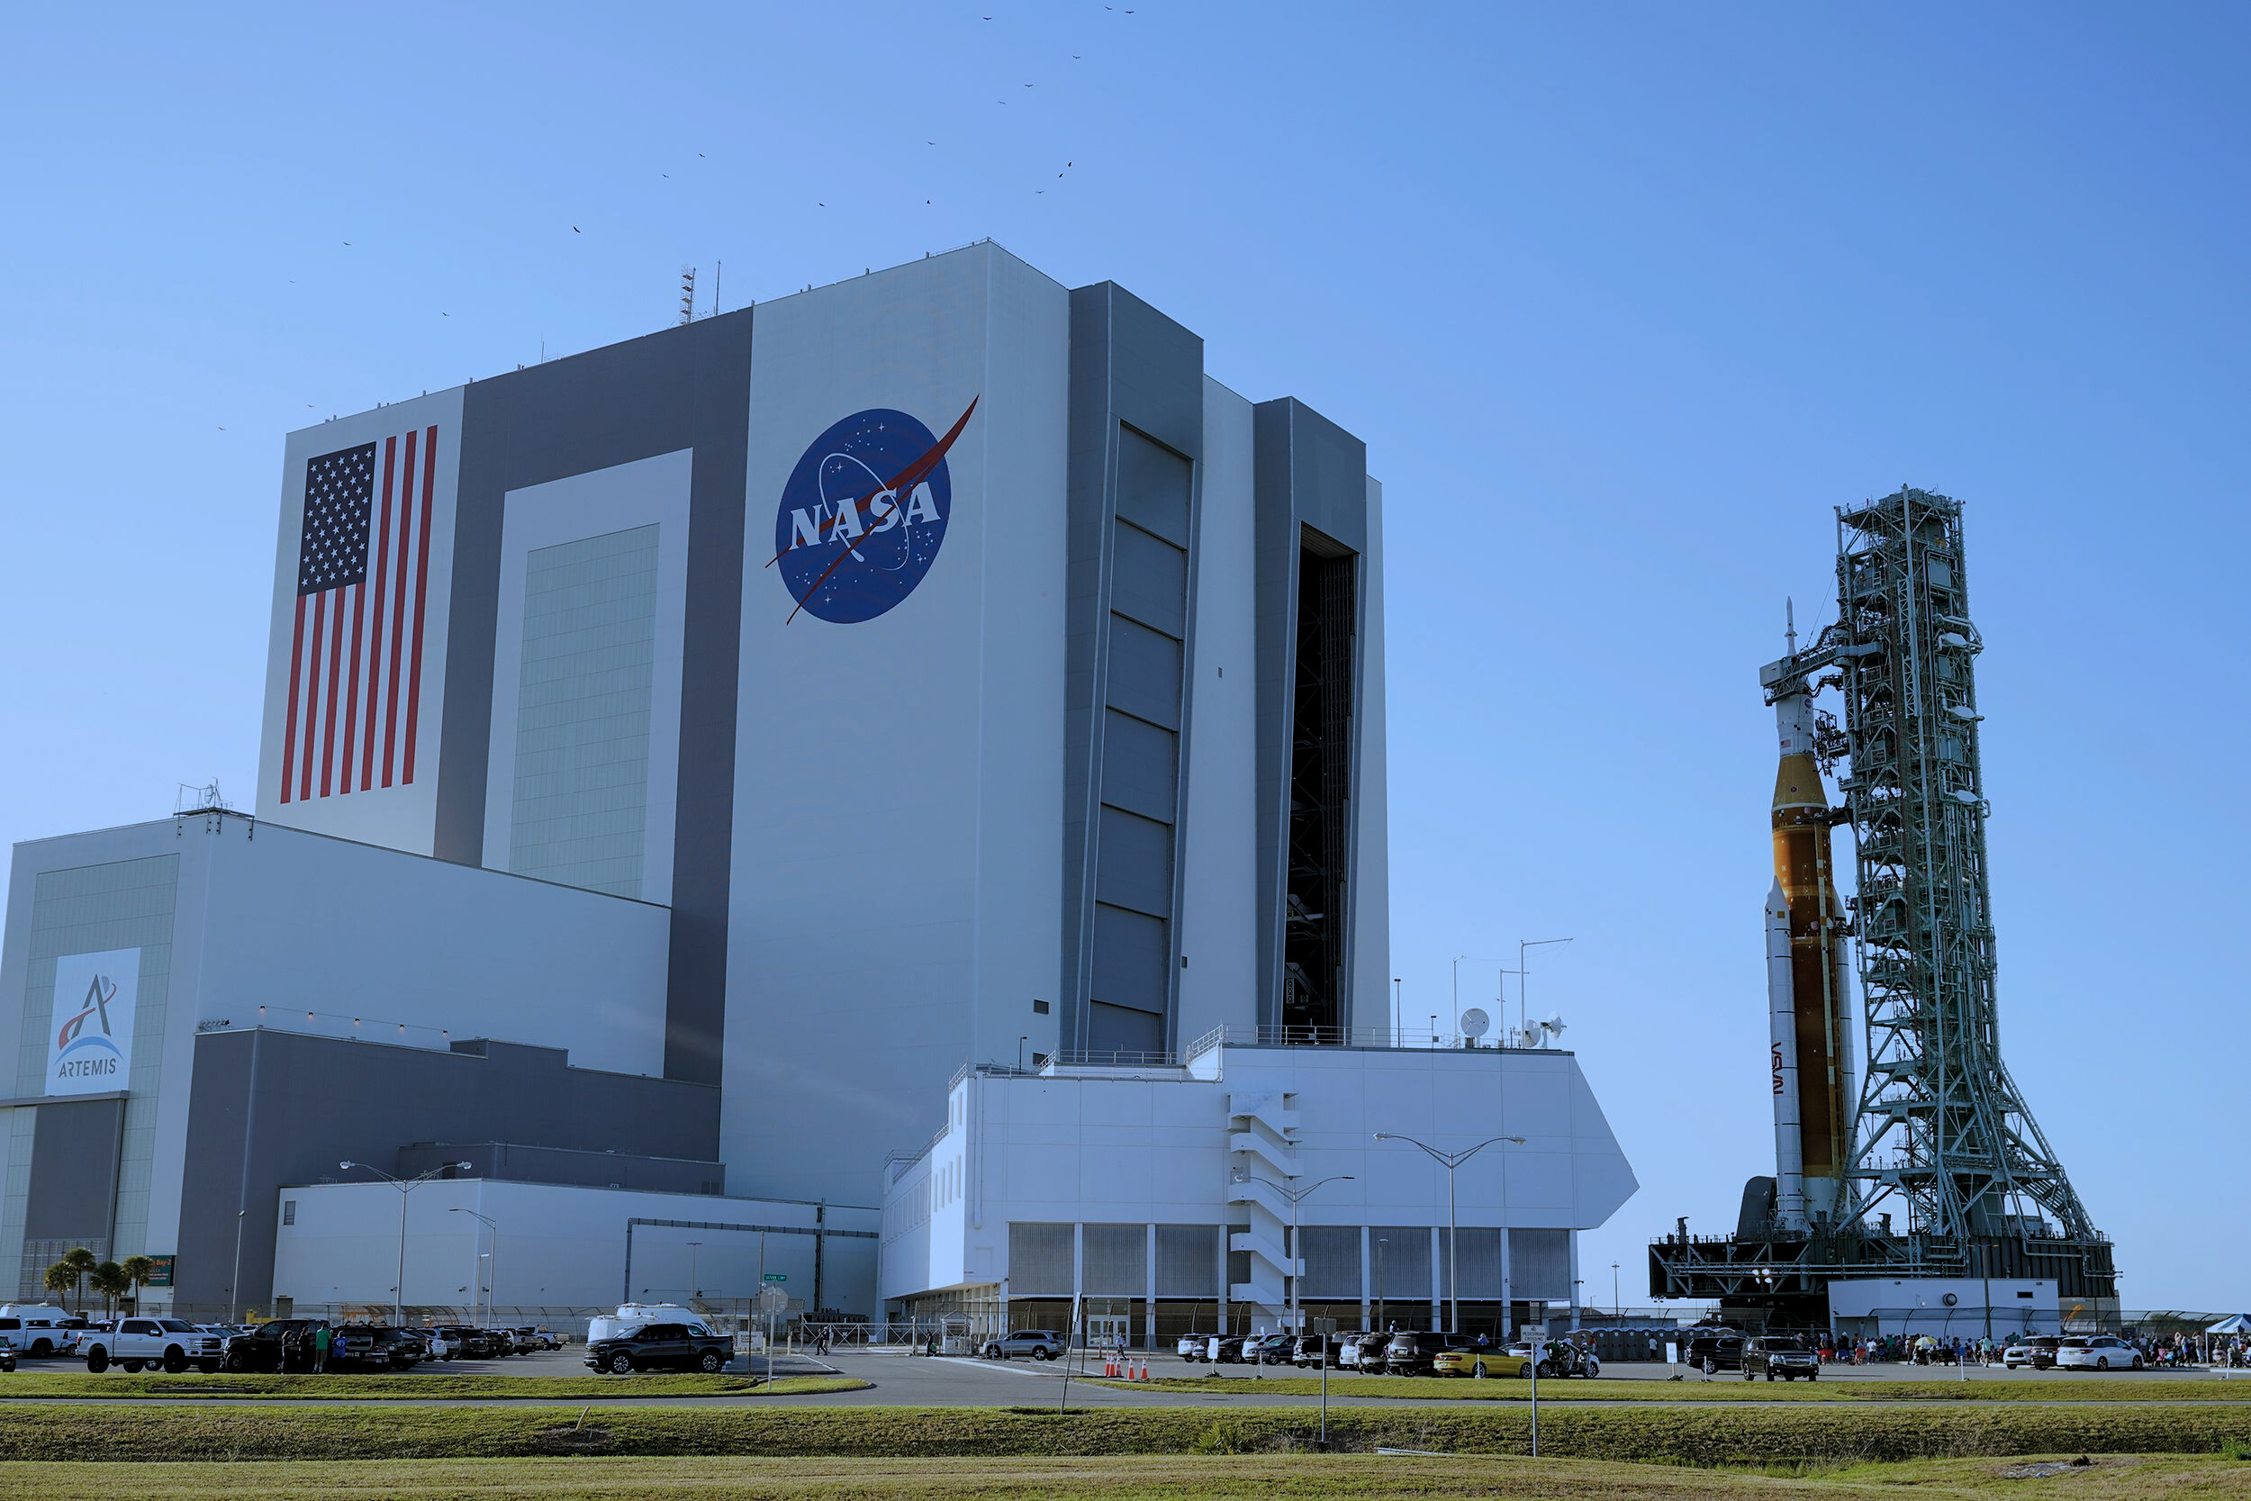
Results

Slide 17

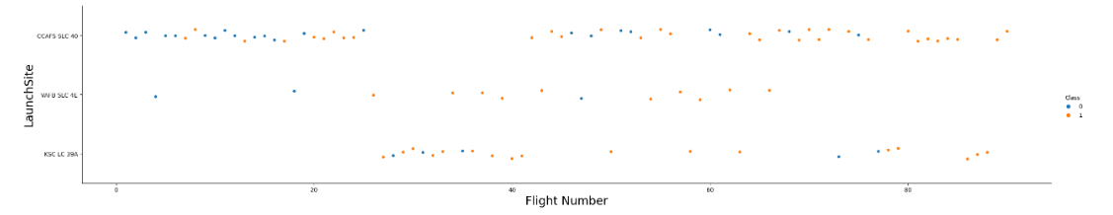
EDA with Visualization
Flight Number vs. Launch Site
Results:
The earliest flights all failed while the latest flights all succeeded
The CCAFS SLC 40 launch site has about a half of all launches
VAFB SLC 4E and KSC LC 39A have higher success rates
It can be assumed that each new launch has a higher rate of success

Slide 18
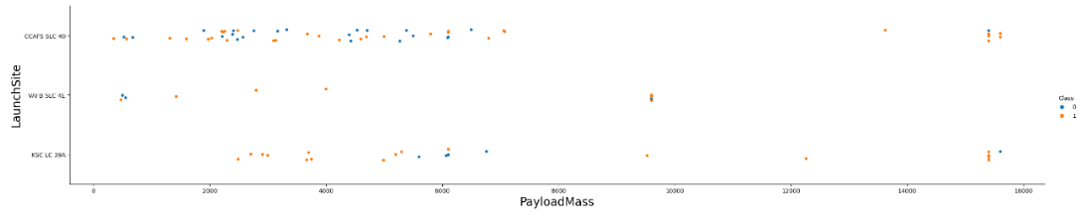
Payload vs. Launch Site
Results:
For every launch site the higher the payload mass, the higher the success rate
Most of the launches with payload mass over 7000 kg were successful
KSC LC 39A has a 100% success rate for payload mass under 5500 kg too

Slide 19
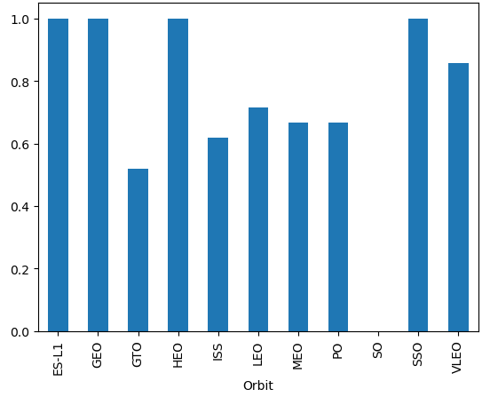
Success rate vs. Orbit type
Results:
ES-L1, GEO, HEO, SSO = 100% success rate
• SO = 0% success rate
• GTO, ISS, LEO, MEO, PO = 50% - 85% success rate

Slide 20
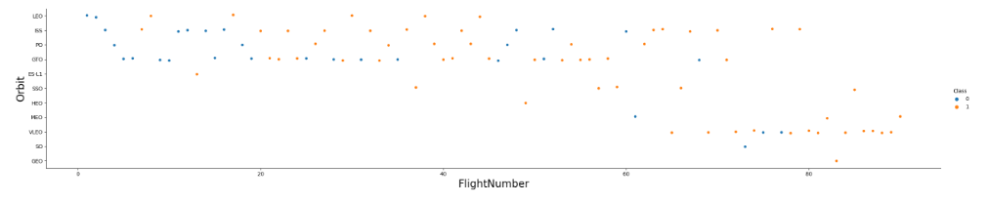
Flight Number vs. Orbit type
Results:
LEO orbit the Success appears related to the number of flights; on the other hand, there seems to be no relationship between flight number when in GTO orbit

Slide 21
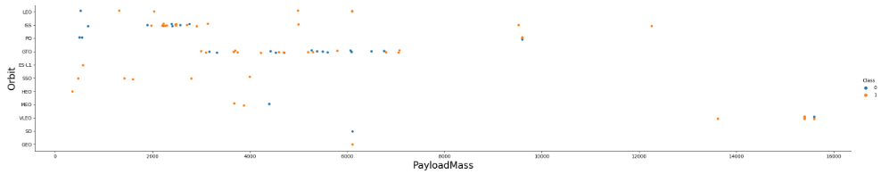
Payload Mass vs. Orbit type
Results:
Heavy payloads have a negative influence on GTO orbits and positive on GTO and Polar LEO (ISS) orbits

Slide 22
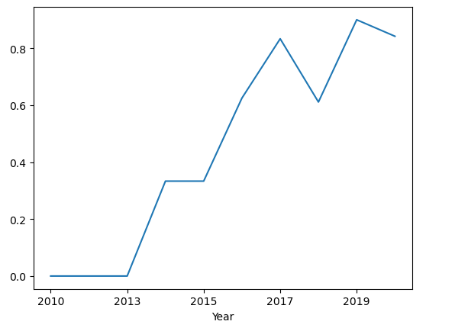
Launch success yearly trend
Results:
The success rate since 2013 kept increasing till 2020

Slide 23
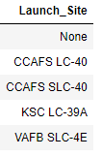
EDA with SQL
All launch site names
They are obtained by selecting unique occurrences of “launch_site” values from the dataset

Slide 24
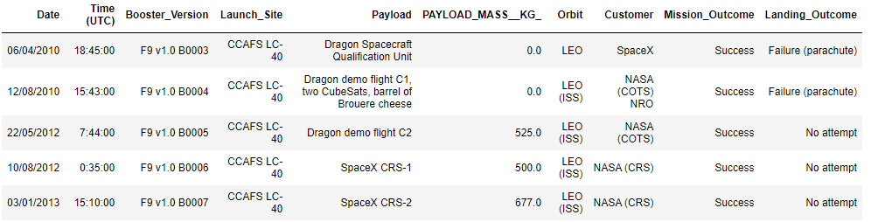
Launch site names begin with “CCA”
Five samples of Cape Canaveral launches

Slide 25
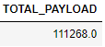
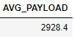
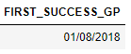
Total Payload Mass
Displaying the total payload mass carried by boosters launched by NASA (CRS)
Average payload mass by F9 v1.1
Displaying average payload mass carried by booster version F9 v1.1
First successful ground landing date
Listing the date when the first successful landing outcome in ground pad was achieved

Slide 26
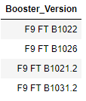
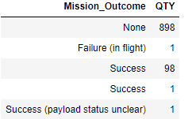
Successful drone ship landing with payload between 4000 and 6000
Listing the names of the boosters which have success in drone ship and have payload mass greater than 4000 but less than 6000
Total number of successful and failure mission outcomes
Listing the total number of successful and failure mission outcomes

Slide 27
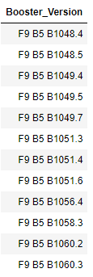
Successful drone ship landing with payload between 4000 and 6000
Listing the names of the boosters which have success in drone ship and have payload mass greater than 4000 but less than 6000

Slide 28
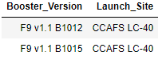
2015 Launch Records
Failed landing outcomes in drone ship, their booster versions, and launch site names for in year 2015

Slide 29

Interactive Maps with Folium

Slide 30
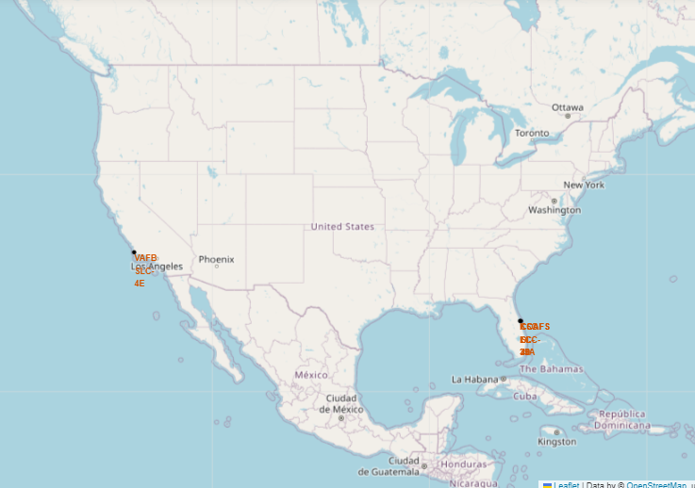
All launch sites’ location markers on a global map
All launch sites are in very close proximity to the coast, while launching rockets towards the ocean it minimises the risk of having any debris dropping or exploding near people

Slide 31
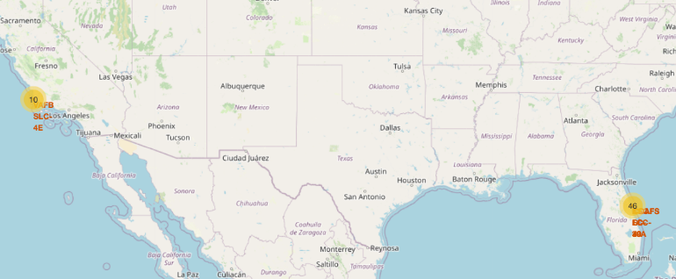
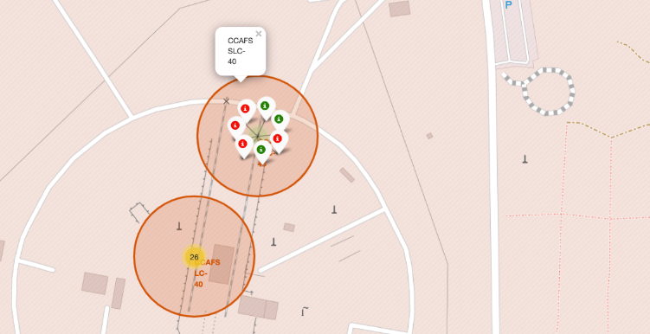
Launch Outcomes by Site
In this example green markers indicate successful and red ones indicate failure

Slide 32
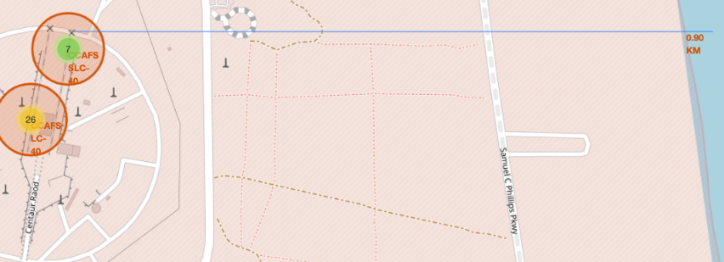
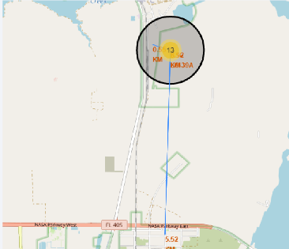
Logistics and Safety
Launch sites are usually uninhabited areas and close to railroads and roads, so they have optimal logistics and security.

Slide 33
Build a Dashboard with Plotly Dash

Slide 34
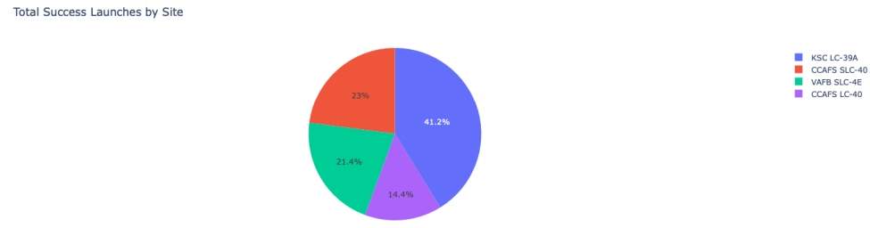
Launch success count by site
The chart clearly shows that from all the sites, KSC LC-39A has the most successful launches

Slide 35
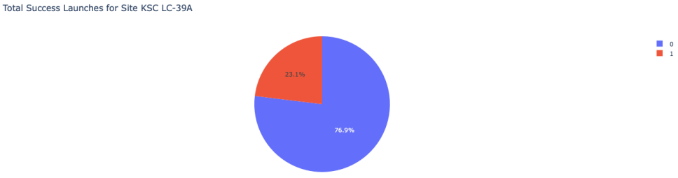
Launch site with highest launch success ratio
KSC LC-39A has the highest launch success rate (76.9%) with 10 successful and only 3 failed landings

Slide 36
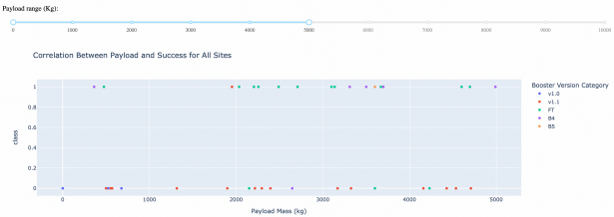
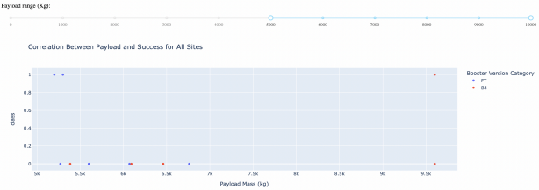
Payload Mass vs. Launch Outcome for all sites
The charts show that payloads between 2000 and 5500 kg have the highest success rate.

Slide 37
Predictive Analysis
(Classification)

Slide 38
Classification Accuracy
As you can see on the next slide, we used four methods:
Logistic Regression
Support Vector Machines
Decision Trees
K-Nearest Neighbors
These methods obtained similar results. However, the best was the Decision Tree that obtained a success of 89%.

Slide 39
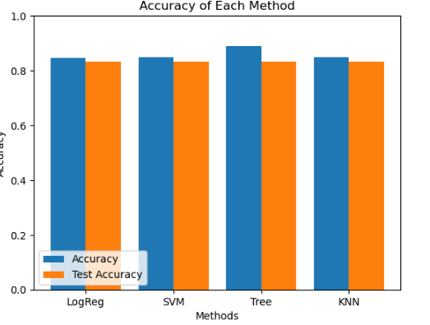
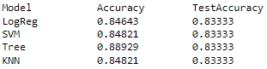

Slide 40
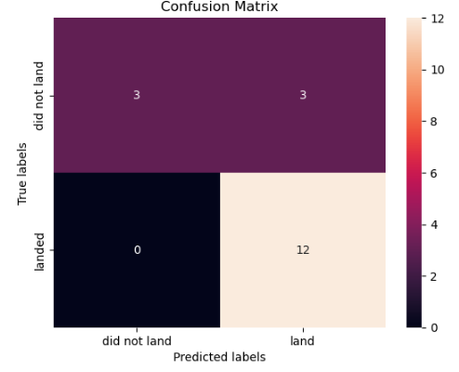
Confusion Matrix of Decision Tree Classifier
Confusion matrix of Deicision Tree Classifier proves its accuracy by showing the big numbers of true positive and true negative compared to false ones

Slide 41
Conclusions
The success of a mission can be explained by several factors such as the launch site, the orbit and especially the number of previous launches. Indeed, we can assume that there has been a gain in knowledge between launches that allowed to go from a launch failure to a success.
The orbits with the best success rates are GEO, HEO, SSO, ES-L1.
Depending on the orbits, the payload mass can be a criterion to take into account for the success of a mission. Some orbits require a light or heavy payload mass. But generally low weighted payloads perform better than the heavy weighted payloads.
For this dataset, we choose the Decision Tree Algorithm as the best model even if the test accuracy between all the models used is identical. We choose Decision Tree Algorithm because it has a better train accuracy.
KSC LC-39A has the highest success rate of the launches from all the sites.

Slide 42
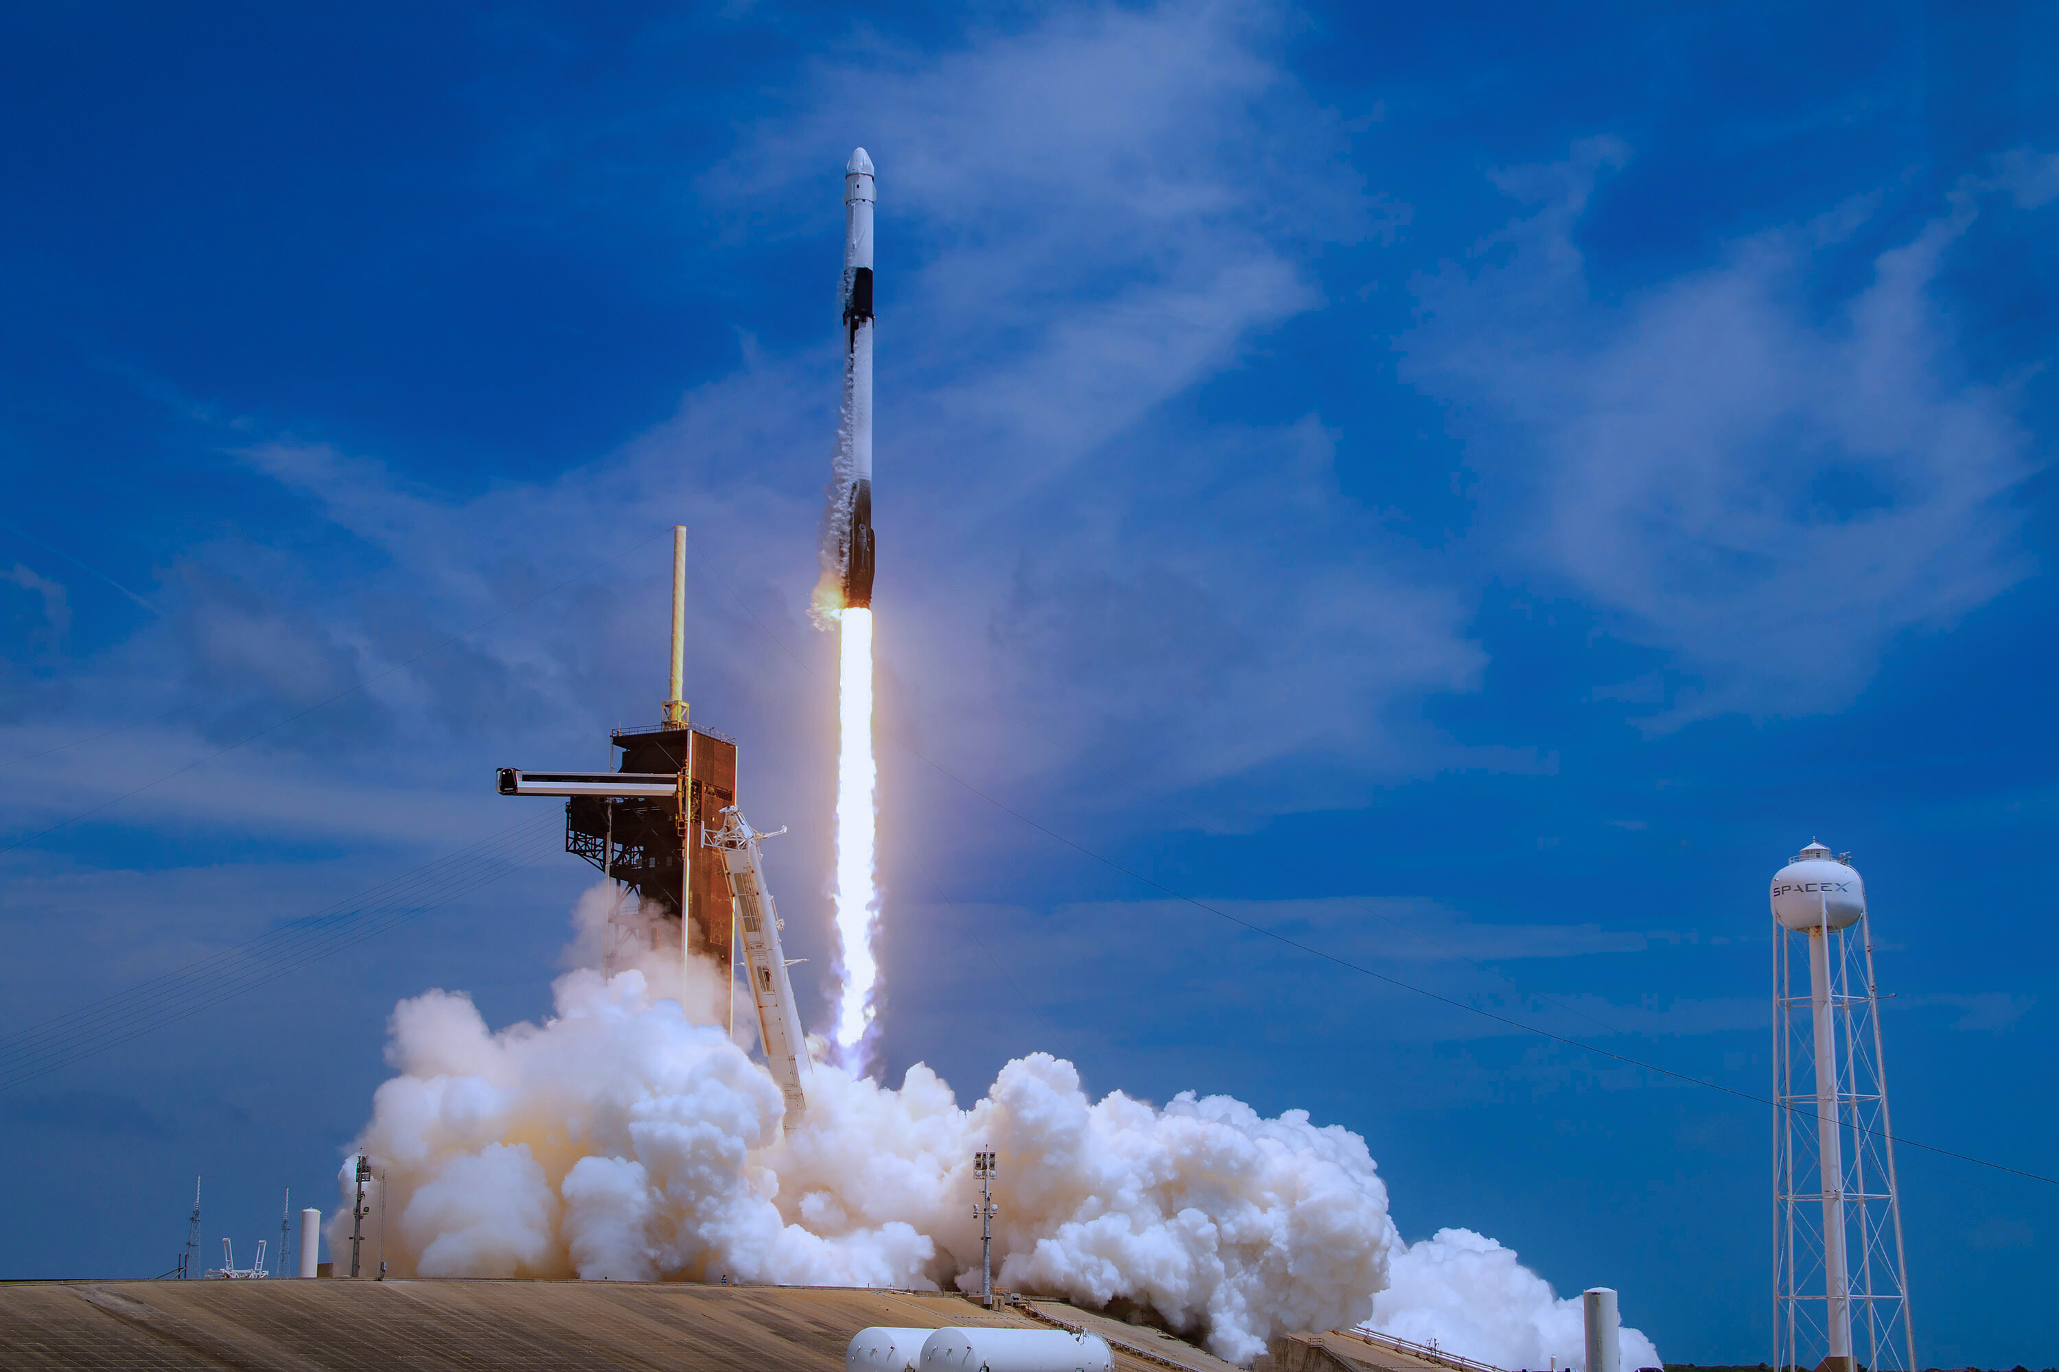


Appendix
Special thanks to:

